Slide 1
Uber Demand-Supply Gap Analysis
Tool Used:
Python
SQL
Excel
Prepared By:
Kavirethna P

Slide 2
BUSINESS PROBLEM
Challenges Faced by Uber: • Ride cancellations • No Cars Available issues • Driver shortages during peak hours • Customer dissatisfaction
Project Objective:
Identify the demand-supply gap and provide business recommendations.

Slide 3
DATASET OVERVIEW
Dataset Size: 6745 Records
Important Fields:
• Request ID • Pickup Point • Driver ID • Status • Request Timestamp • Drop Timestamp
Status Categories:
• Trip Completed • Cancelled • No Cars Available

Slide 4
DATA CLEANING & PREPROCESSING
Activities Performed: • Datetime Conversion • Missing Value Analysis • Request Hour Creation • Time Slot Creation • Data Type Standardization
Key Observation:
Missing values were business-valid and retained for analysis.

Slide 5
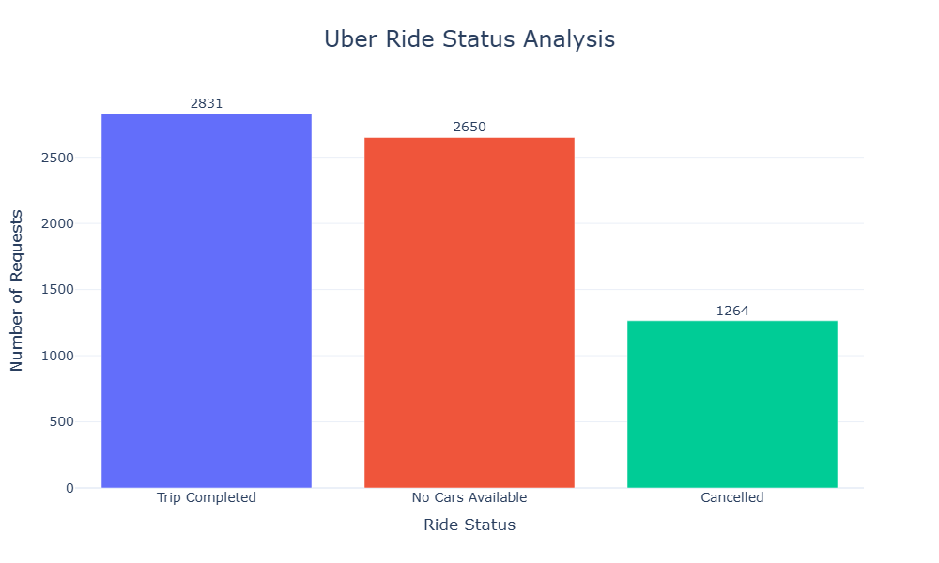
RIDE STATUS ANALYSIS
Key Findings:
• Trip Completed: 2831 • No Cars Available: 2650 • Cancelled: 1264
Business Impact:
Large number of unsuccessful ride requests.

Slide 6
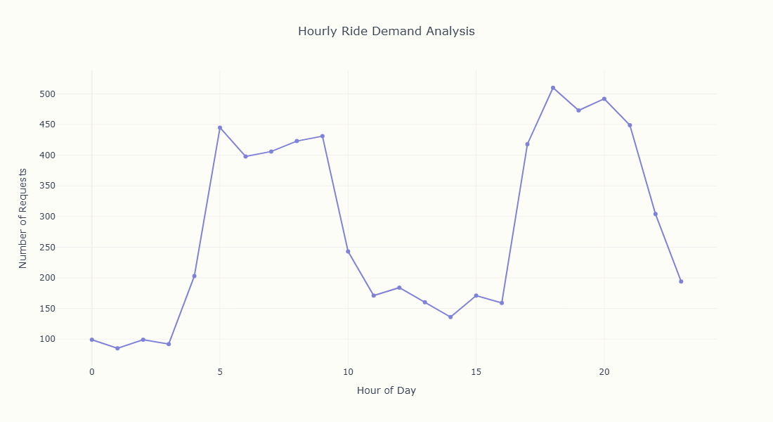
HOURLY DEMAND ANALYSIS
Key Findings:
• Demand concentrated during specific hours • Peak-hour demand exceeds driver availability
Business Impact:
Higher demand-supply gap during peak periods.

Slide 7
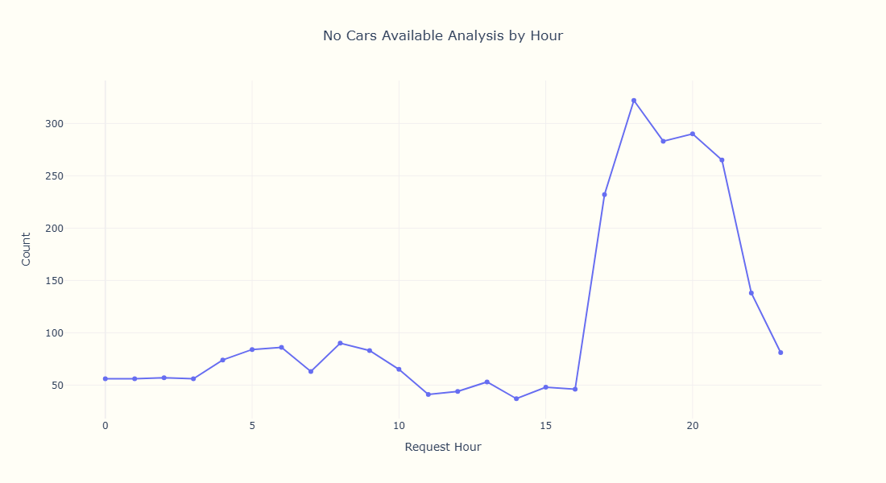
NO CARS AVAILABLE ANALYSIS
Key Findings:
• Significant driver shortage observed • Supply unable to meet customer demand
Business Impact:
Lost revenue and poor customer experience.

Slide 8
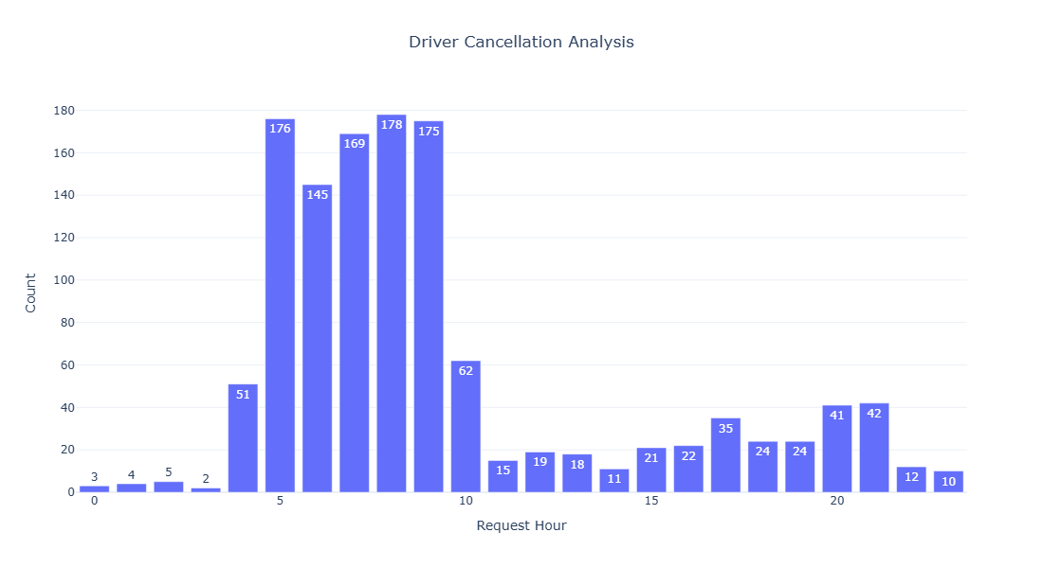
CANCELLATION ANALYSIS
Key Findings:
• Driver cancellations contribute significantly to failed rides
Business Impact:
Reduced customer trust and reliability.

Slide 9
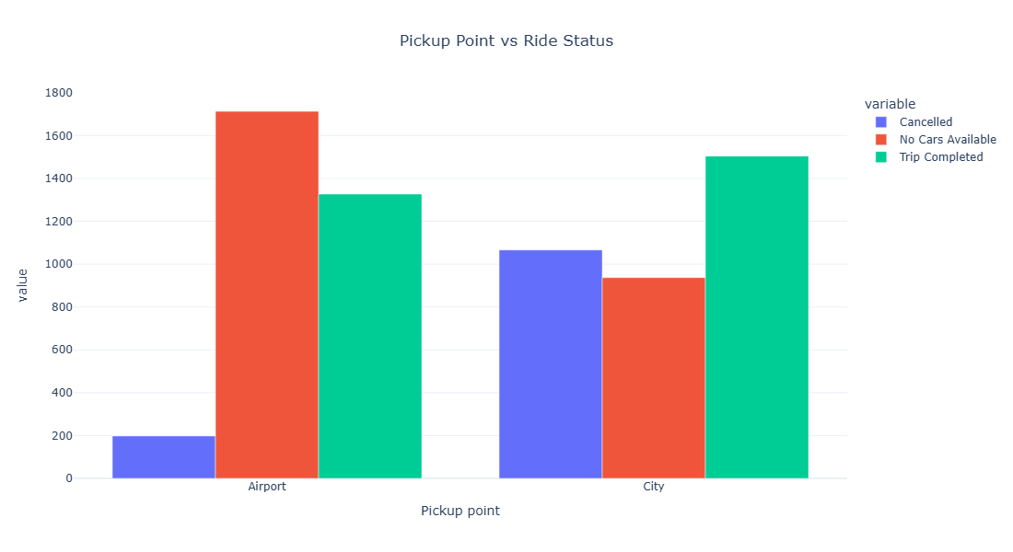
AIRPORT VS CITY ANALYSIS
Key Findings:
• Airport location shows higher supply shortages
Business Impact:
Need better driver allocation near airports.

Slide 10
SQL ANALYSIS
Queries Performed:
• Ride Status Analysis • Demand by Hour • Cancellation Analysis • No Cars Available Analysis • Pickup Point Analysis
Purpose:
Validate business insights using SQL.

Slide 11
EXCEL DASHBOARD

Slide 12
KEY BUSINESS INSIGHTS
Significant demand-supply gap exists.
Peak-hour driver shortages affect service quality.
Airport pickups experience more supply issues.
Driver cancellations reduce ride completion rates.

Slide 13
RECOMMENDATIONS
• Increase drivers during peak hours • Improve airport driver allocation • Reduce driver cancellations • Introduce driver incentive programs • Implement smart driver allocation

Slide 14
CONCLUSION
The analysis identified major demand-supply gaps caused by driver shortages and ride cancellations. Strategic driver allocation and peak-hour planning can significantly improve ride completion rates and customer satisfaction.

Slide 15
THANK YOU

